Slide 1

Customer ratings analysis and insights

Slide 2

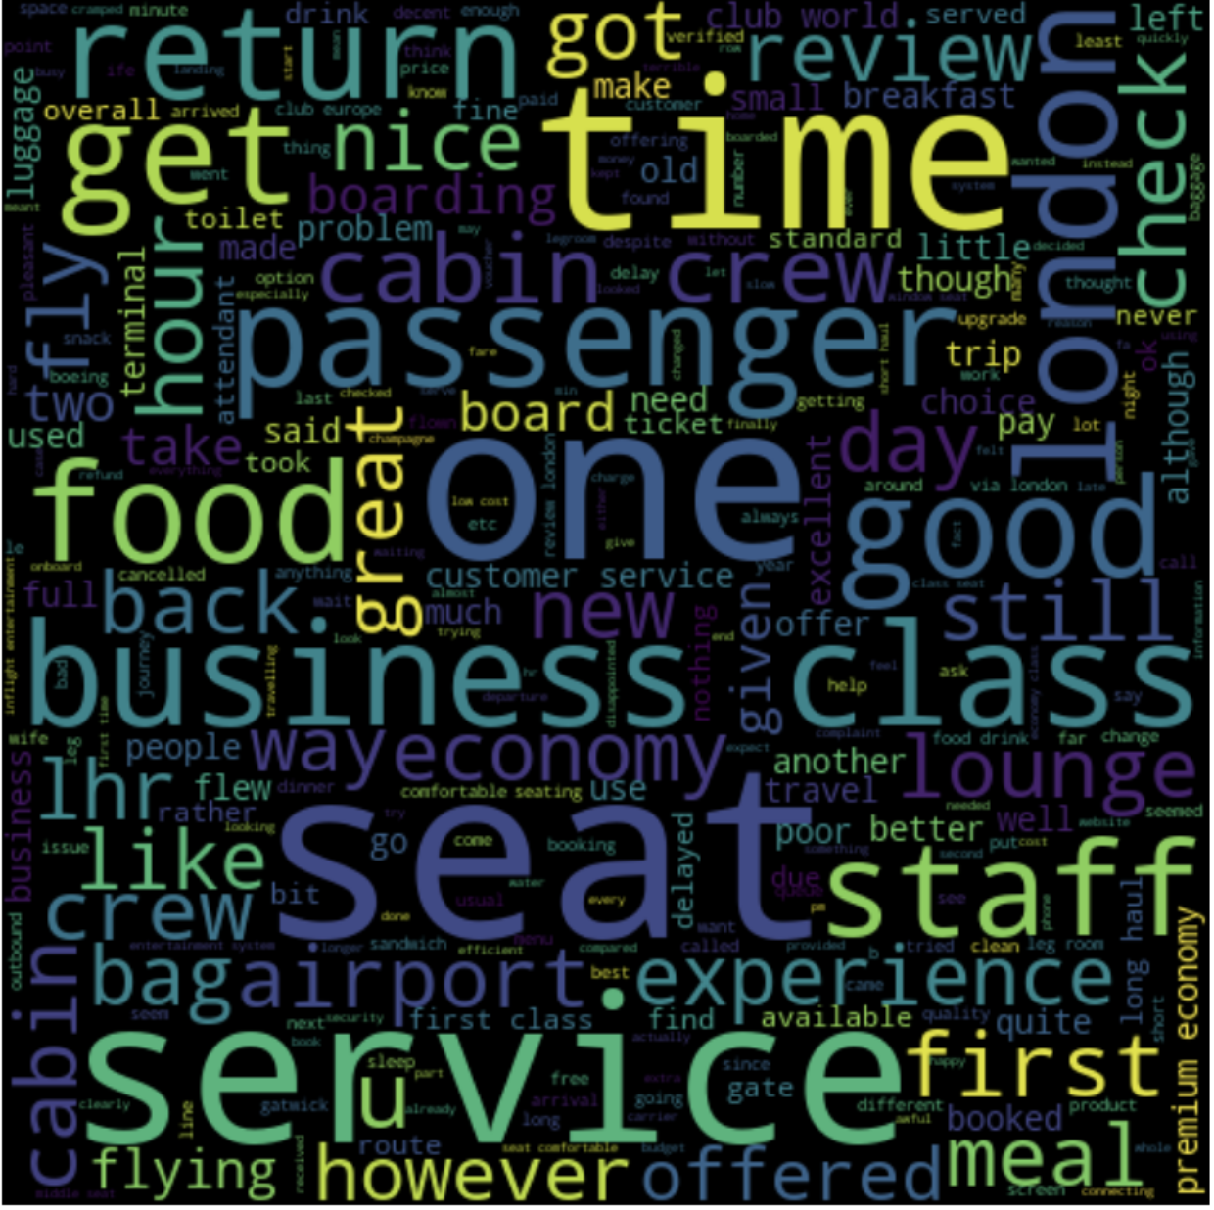
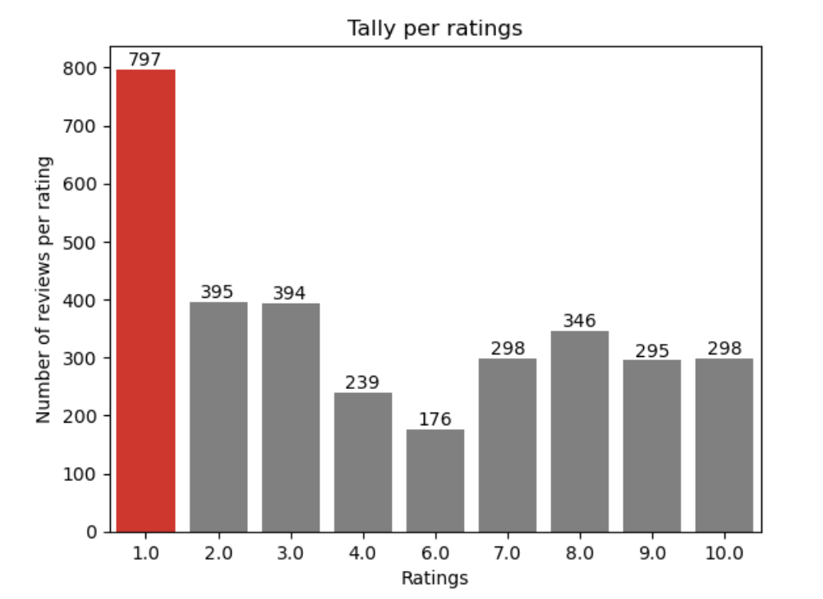
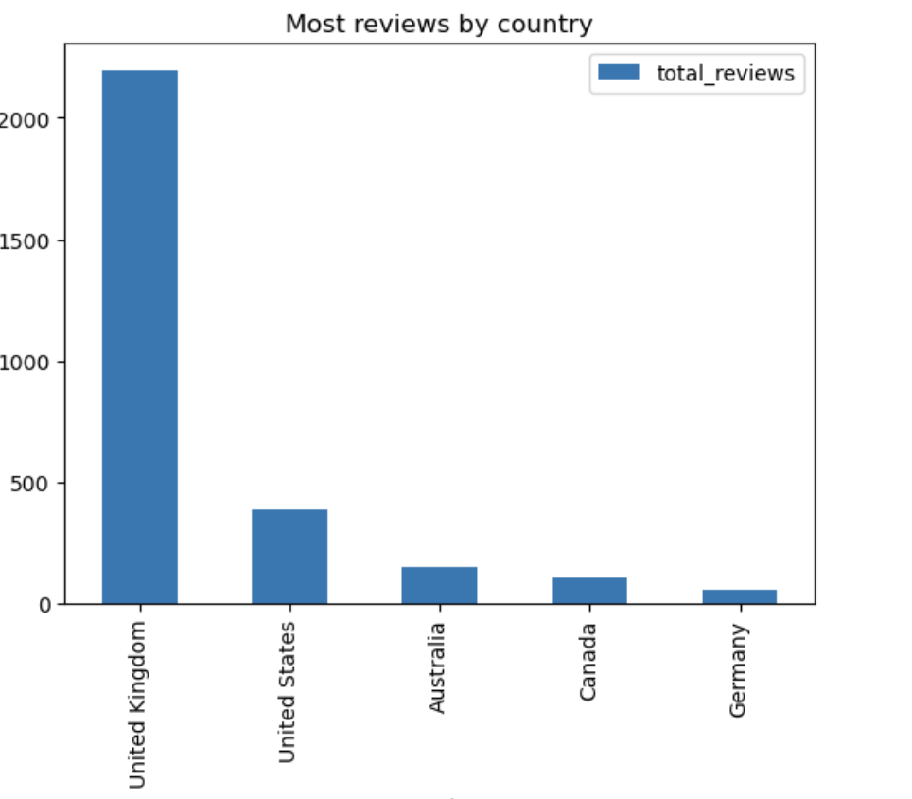
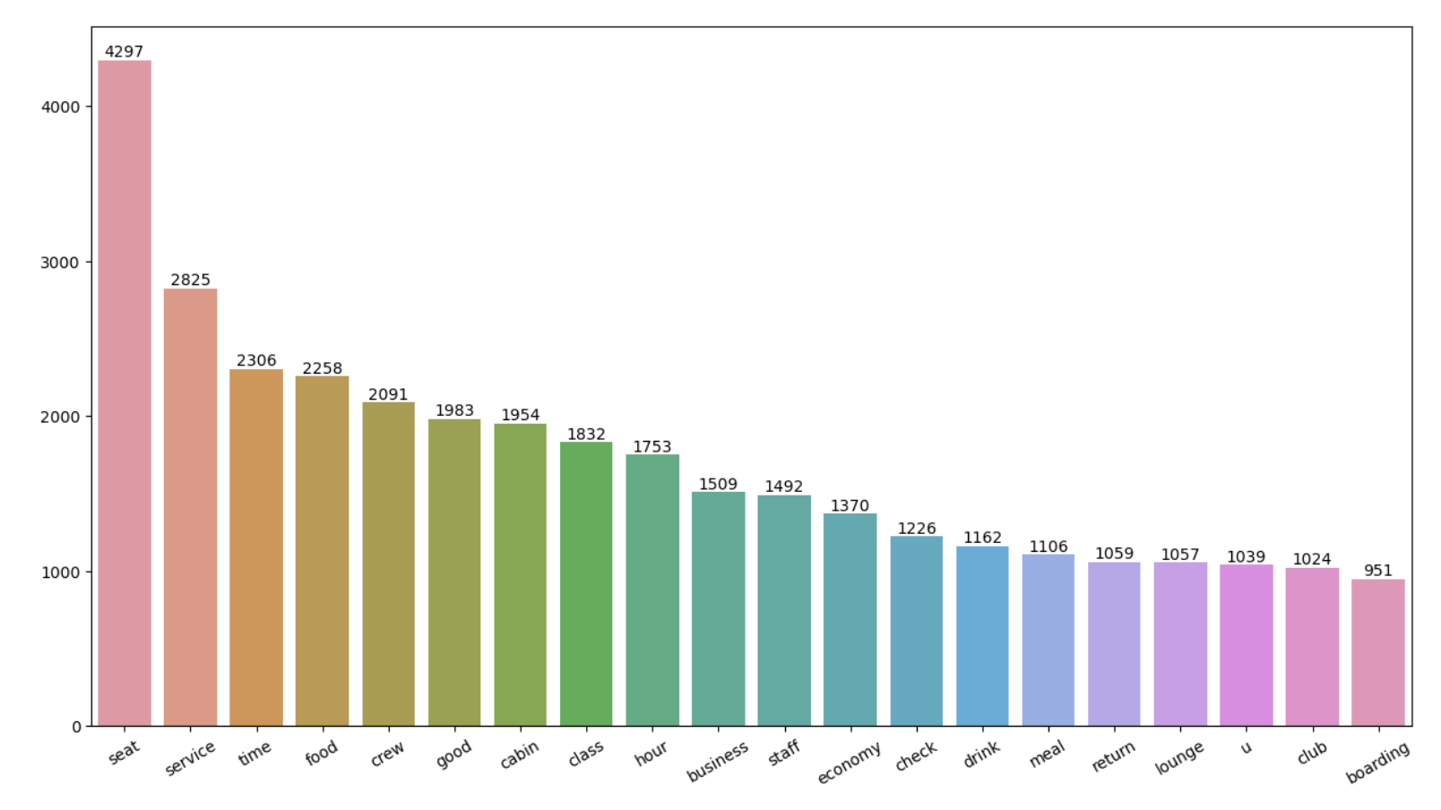
KEY METRICS
Average Overall rating ⭐
4.72 / 10
Total number of reviews collected 3493
Reviews from
69 unique countries
Reasons for Passenger ratings:
For Ratings 7-10:
- Praise for comfortable seats.
- Positive feedback on good inflight entertainment.
- Compliments for decent food quality.
For Ratings 4-6:
- Mention of issues with small entertainment screens.
- Complaints about long passport check queues.
- Dissatisfaction with the business class experience.
For Ratings 1-3:
- Expressing dissatisfaction with congested middle seats.
- Criticism of small screens.
- Appreciation for the seats and food.
Passengers expressed their satisfaction with the cabin crew service and overall experience of economy class seats.. Many travelled in Business class.
The areas of focus should include enhancing the economy class service, improving seating comfort, elevating the in-flight entertainment experience, and addressing delays.
It appears that customers desire value for their money; therefore, enhance the business class experience.
Improve Customer service for refund requests and processing.

